Slide 1
Project Three
How to become a Hollywood millionaire

Slide 2
Project Three
What elements can help predict the financial success of a movie?
How can those elements be used to predict such success?

Slide 3
Data
Two years ago, a competition was held on Kaggle.
The challenge was to use an existing data set to predict a movie’s worldwide box office revenue.
Despite the fact we were two years late to the party, we decided to use the provided data set to attempt our own prediction using the machine learning library known as Scikit-Learn.

Slide 4
Which type of model to use?
Considerations
Factors
We’re noobs.
Our dataset was “relatively” small.
The time frame was...compressed.
We wanted to know which inputs were most important to the prediction.
Random forest algorithms are relatively simple.
This makes it ideal for a group of noobs with a deadline.
Random forest algorithms are ideal for high-dimensional datasets (another relative term, but we wanted to use several different attributes).
Random forest algorithms make it easy to know measure the relative importance of each feature on the prediction and Sklearn provides an easy tool for such an analysis.

Slide 5
Attempted models
Multiple Input Linear Regression
Random Forest Classifier
Random Forest Regression
Neural Network

Slide 6
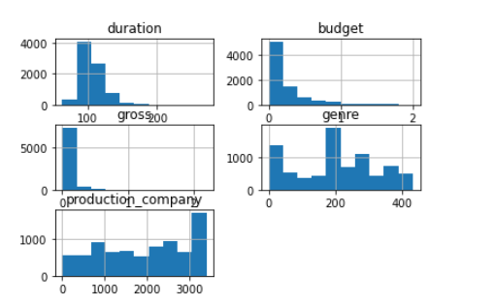
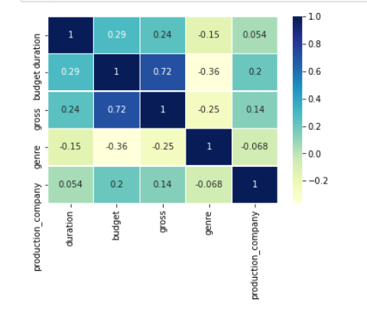
Data Analysis From this correlation heat map, we can see that gross revenue is strongly correlated to budget whereas least correlated to production company.

Slide 7
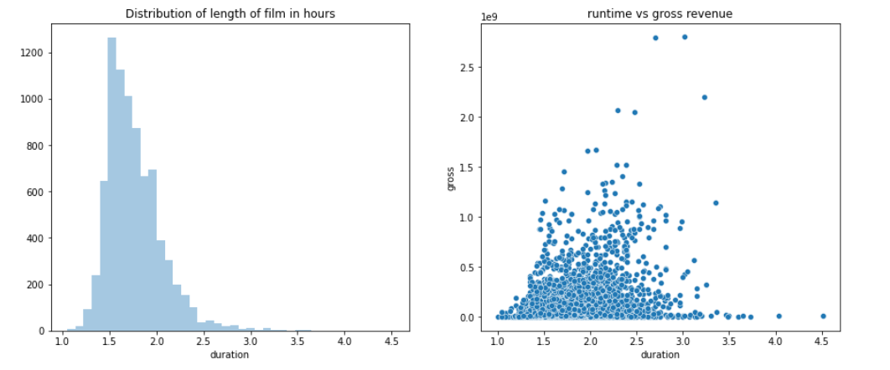
Gross Revenue Vs. duration the plot below shows duration in hour on x-axis and count of movies in on y axis, in this case see that most of the movie are between 1.5 to 3 hrs. and the movie that fall on this duration has highest revenue.

Slide 8
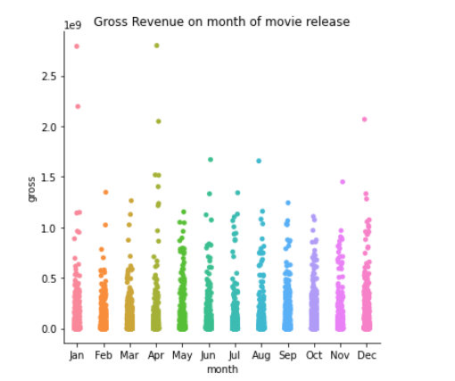
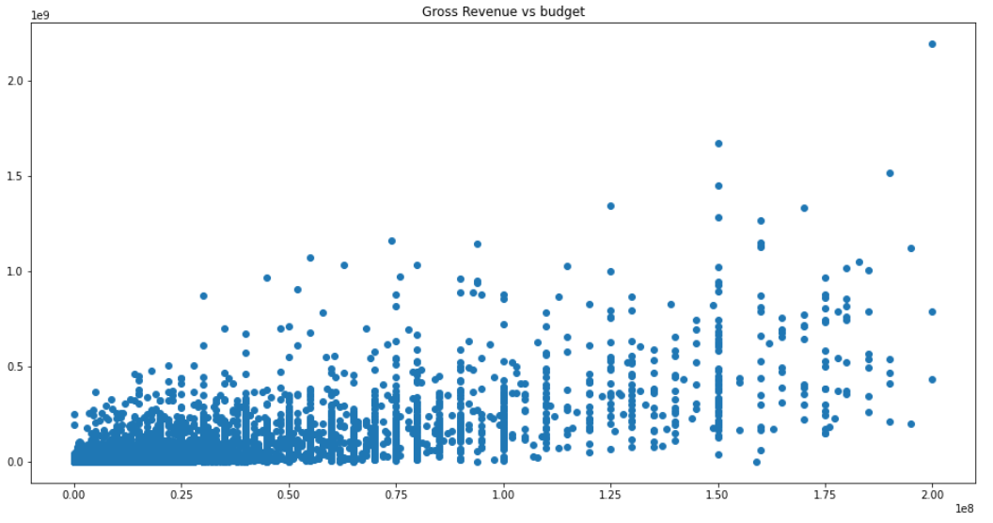
Release month and Budget vs. Revenue From this figure, we can see that movies released in Jauary and April have highest Gross revenue. Also, we can see that there is correlation between budget and revenue, but we are not clear of the degree of correlation from this plot.

Slide 9

Process
Data Preparation
Split data into “train” and “test”
Train model with the “train” data
Use CountVectorizer method to create a matrix of token counts for “genre” and “language.”
Test model with “test” data
Score model

Slide 10

R² Score
Translation: Almost 90% of the variance in our prediction of gross revenue is predictable based on our inputs.

Slide 11
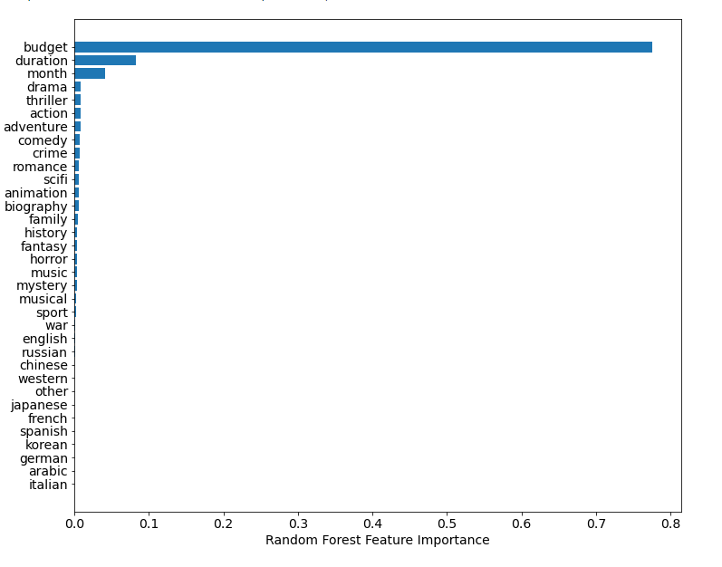
Feature Importance

